Slide 1
Structured
Knowledge Representation
Dave Touretzky
Read R&N Chapter 12

Slide 2
What is knowledge representation?
An attempt to formalize human knowledge in ways that will be computationally useful.
A prerequisite for AGI (Artificial General Intelligence).
Isn’t this really philosophy?
Yes, the problem dates back to Aristotle.
But philosophers don’t have to test their theories by writing code that works.
Isn’t this really cognitive science?
Cognitive science has made important contributions, e.g., examining how human category learning works.
But AI has a different focus: it requires implementable algorithms.

Slide 3
Ontology: what are the different kinds of stuff?
Natural kinds: cats, flowers, rocks, comets, tornadoes
Places: Pittsburgh, North America, the Starbucks on Craig Street
Organizations: companies, clubs, unions, political parties
Mental phenomena: thoughts, emotions, memories, beliefs, instincts
Linguistic phenomena: languages, dialects, words, phrases, idioms
Mathematical objects: numbers, functions, relations, theorems, axioms
Political/economic philosophies: capitalism, communism, socialism, Marxism
Physiological phenomena: digestion, respiration, reproduction, sleep
Games: checkers, chess, backgammon, go, poker, bridge, solitaire
Kinship relations: parent, grandparent, sibling, aunt, uncle, cousin, spouse
Tools: hammer, screwdriver, wrench, saw, file, crowbar, MATLAB
Food: pizza, pad thai, souvlaki, lo mein, duck a l’orange

Slide 4
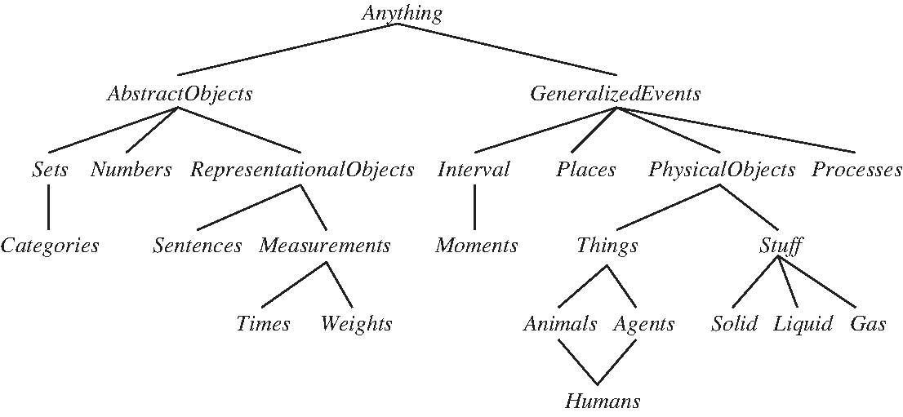
An “upper ontology” of the world

Slide 5
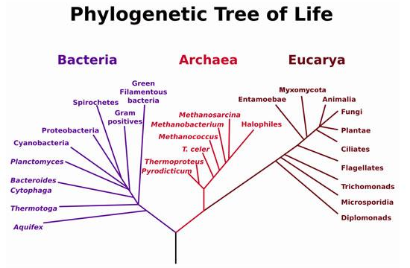
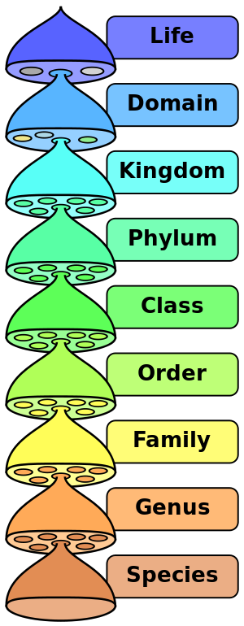
Taxonomic Hierarchies
10 million living and extinct species.

Slide 6
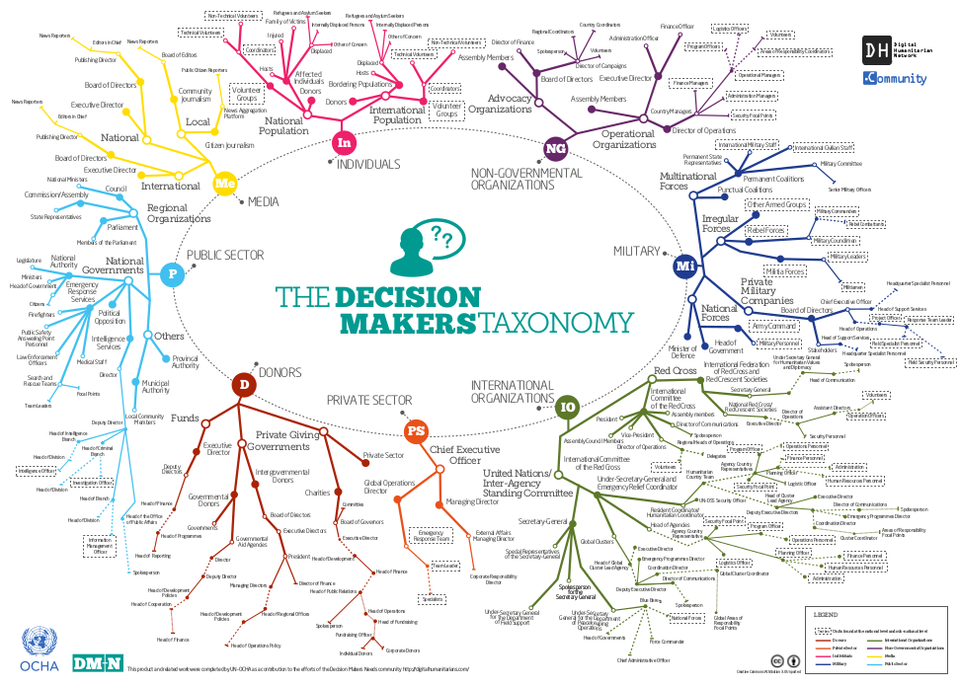
https://reliefweb.int/report/world/decision-makers-taxonomy

Slide 7
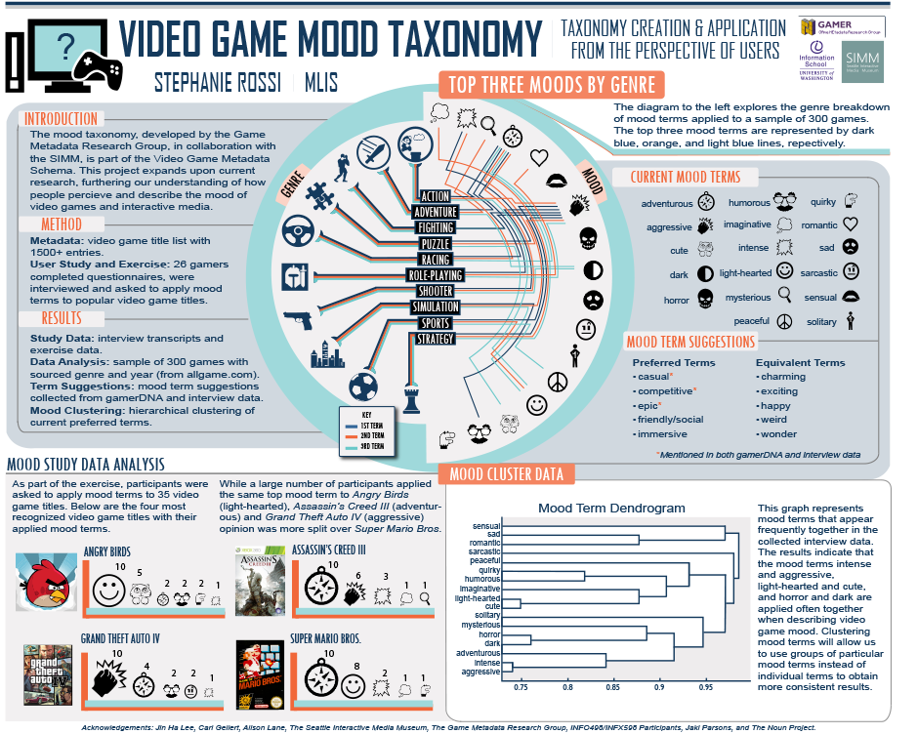

Slide 8
Semantic Networks
A graphical representation for some types of knowledge.
Once viewed as an “alternative” to logic. (It’s not really.)
The IS-A relation often forms the backbone of a semantic network.
Vertebrate
IS-A
Mammal
IS-A
Elephant
InstanceOf
Clyde

Slide 9
Many ways to partition a category
Persons
Male vs. female
Adult vs. child
Real vs. fictional
Living vs. dead
Male / Female partitions multiple categories
Male or female persons
Male or female chickens (roosters are males; hens are females)

Slide 10
Category relations
Subset(Mammals, Vertebrates)
Disjoint({Animals, Vegetables})
ExhaustiveDecomposition({Americans, Canadians, Mexicans}, NorthAmericans)
Some people have dual citizenship.
Partition({Males, Females}, Animals)
Partition(s,c) ⇔ Disjoint(s) ∧ ExhaustiveDecomposition(s,c)

Slide 11
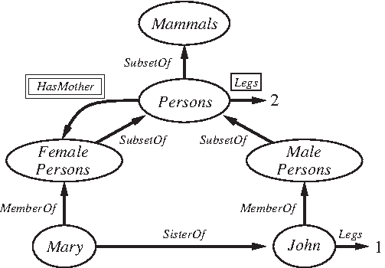
Semantic networks with relations

Slide 12
Part-Of hierarchies in semantic networks
Human body
Limbs
Arm IS-A Limb
Forearm
Elbow IS-A Joint
Hand
Finger
Knuckle IS-A Joint
Fingernail
Limb IS-A BodyPart
Bones
Muscles
Joints
Skin
An arm has bones because arms are limbs and limbs have bones.
The bones of the hand are bones of the arm because hands are parts of arms.

Slide 13
Description logics
Concept → Thing | ConceptName | And(Concept, …) | All(RoleName, Concept), | AtLeast(Integer, RoleName) | AtMost(Integer, RoleName) | Fills(RoleName, IndividualName, …) | SameAs(Path, Path) | OneOf(IndividualName, …)
Path → [RoleName, …]

Slide 14
Description logic examples
Bachelors are unmarried adult males.
Bachelor = And (Unmarried, Adult, Male)
Bachelor(x) ⇔ Unmarried(x) ∧ Adult(x) ∧ Male(x)
Men with at least three sons who are all unemployed and married to doctors, and at most two daughters who are all professors in physics or math departments.
And(Man, AtLeast(3, Son), AtMost(2, Daughter), All(Son, And(Unemployed, Married, All(Spouse, Doctor))), All(Daughter, And(Professor, Fills(Department, Physics, Math))))
Saying this in FOL would be a bit cumbersome.

Slide 15
Inference in semantic nets
Transitive closure over IS-A or Part-Of is easy to compute.
Is Clyde a vertebrate? Yes!
Are fingernails parts of the body? Yes!
Equivalent to Horn theories in FOL:
∀x Elephant(x) ⇒ Mammal(x)
∀x,y,z PartOf(x,y) ∧ PartOf(y,z) ⇒ PartOf(x,z)
Can be answered by forward chaining.
So why is human-like reasoning hard?
Because reality is much messier than this.

Slide 16
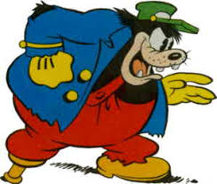
Exceptional individuals
People have two legs.
Pegleg Pete has one leg.
How do we avoid contradiction?
Nonmonotonic logic
Default logic
Circumscription
Circumscribe the set “two legged persons” to include all persons not known to have less than two legs.
Asserting Person(pete) allows us to infer that Pete has two legs.
Asserting NumLegs(pete)=1 removes Pete from the set of two-legged persons.
Asserting anything that entails NumLegs(pete)=1 should do the same.
Circumscription is at least NP-hard. Uh oh!

Slide 17
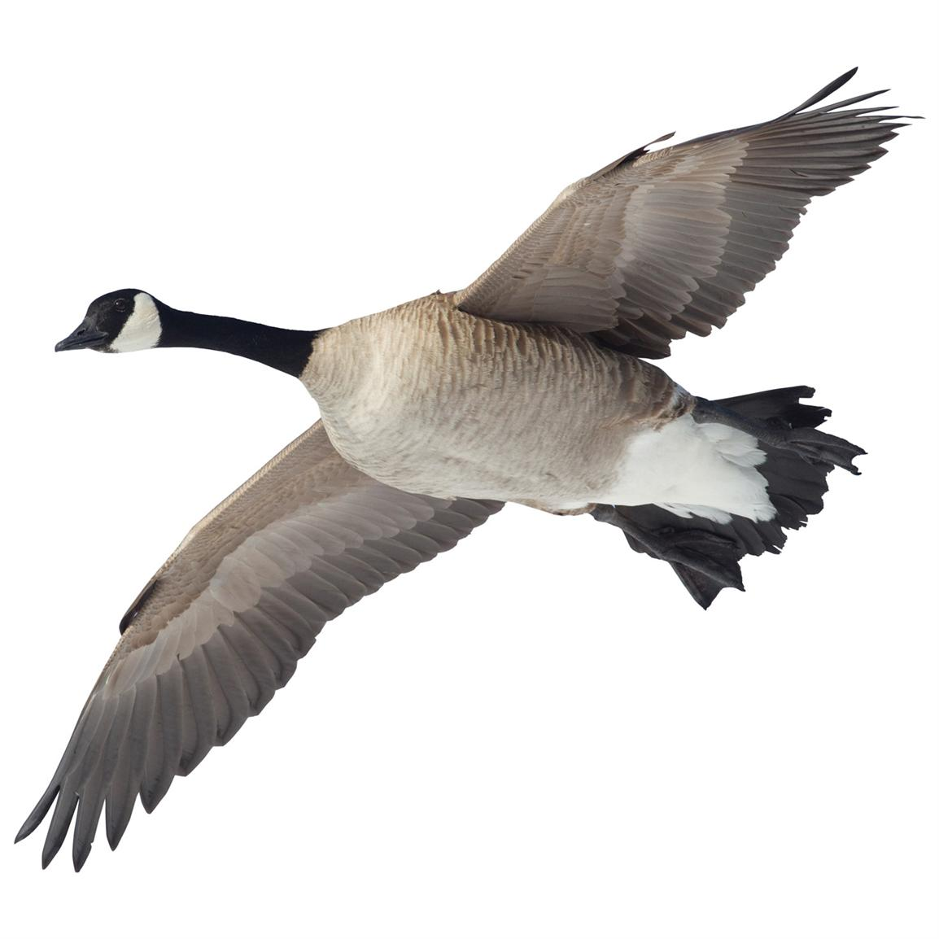
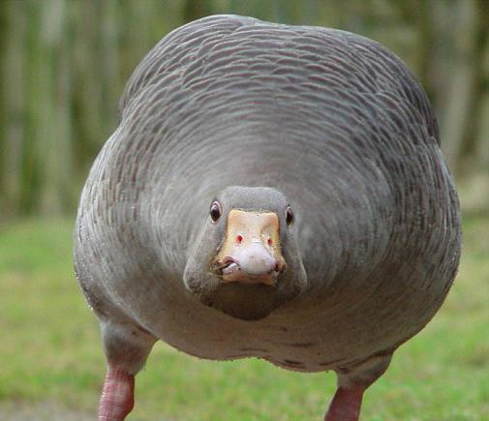
What do we know about birds?
Birds have wings.
Birds fly.
Penguins don’t. Ostriches don’t.
Some geese fly. Some geese don’t.
Birds don’t swim.
Ducks swim.
Penguins swim.
Birds build nests.
Do all birds build nests?
Do ostriches? Do penguins? Do cowbirds?

Slide 18
Typical exemplars; prototypes; outliers
Typical birds:
Robin
Pigeon
The prototypical bird has wings, flies, doesn’t swim, builds a nest, is not domesticated, eats plants and bugs.
Common but not typical:
Chicken (domesticated)
Eagle (size, diet)
Duck (aquatic)
Confidence in inferences about birds may depend on their typicality.

Slide 19
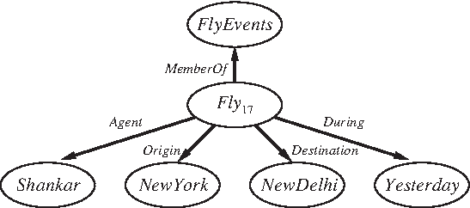
Summing up semantic nets
The graphical notation is only a win for binary relations, where we can trace paths.
With n-ary relations the graphical notation doesn’t contribute much.
Shankar
FlyTo
NewDelhi
Part-Of
India

Slide 20
Summing up semantic nets
Can write ad hoc inference algorithms to efficiently handle things like nonmonotonicity.
How many legs does Mary have?
How many legs does John have?

Slide 21
Summing up semantic nets
Ad hoc inference algorithms may not be sound.
Multiple inheritance can be a source of problems.
Pacifist
SubsetOf
Disjoint
Quaker
Republican
InstanceOf
InstanceOf
Nixon

Slide 22
Circumscription as model preference
Republican(Nixon) ∧ Quaker(Nixon)
Republican(x) ∧ ¬Abnormal₁(x) ⇒ ¬Pacifist(x)
Quaker(x) ∧ ¬Abnormal₂(x) ⇒ Pacifist(x)
Circumscribe on Abnormal₁ and Abnormal₂.
This has two models: one where Nixon is a pacifist, and one where he isn’t.
Could let religion trump politics by prioritizing the minimization of Abnormal₂ over Abnormal₁.

Slide 23
Things vs. stuff
“Things” are discrete objects composed of distinct parts.
Count nouns.
“Stuff” can be divided into smaller amounts of the same stuff.
Mass nouns.
Example: “butter”
Intrinsic (definitional) properties: color, taste, density, melting point
Extrinsic properties: weight, shape, location
Other examples: “energy”, “water”, “territory”

Slide 24
Words vs. concepts
Words can refer to concepts.
But the mapping is ambiguous.
Words often have multiple meanings.
Example: “load” as a noun.
The cargo carried by a vehicle.
The contents of a shotgun shell.
The portion of a circuit that consumes electrical power.
Tasks or obligations, as in “he’s carrying a heavy load this semester”.
These meanings may be metaphorically related. The metaphors are often based on force or motion.

Slide 25
Time and events
Classical planning uses situational calculus, where events are discrete, instantaneous, and happen one at a time.
We need something more powerful if we want to model continuous processes or concurrency.
The event calculus provides tools for this.
Reify fluents and events, turning them into objects.
Define intervals as continuous segments of time with a start and end time: i = (t₁,t₂).
Use predicates such as Happens(e,i) to indicate the interval in which an event happens.

Slide 26
Predicates for event calculus
T(f,t) Fluent f is true at time t.
Happens(e,i) Event e happens during interval i.
Initiates(e, f, t) Event e causes fluent f to start to hold at time t.
Terminates(e, f, t) Event e causes fluent f to cease to hold at time t.
Clipped(f, i) Fluent f ceases to be true at some point during interval i.
Restored(f, i) Fluent f becomes true sometime during interval i.

Slide 27
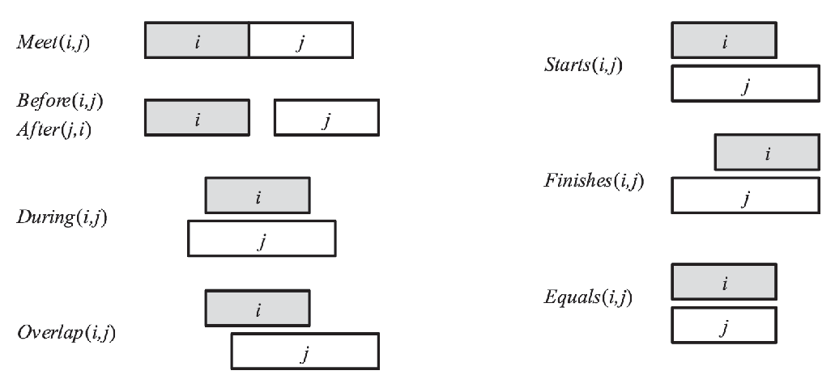
Relationships between intervals

Slide 28
Mental states: knowledge and belief
Agents can have limited knowledge.
Agents can hold beliefs that aren’t true.
Agents are assumed to know all the consequences of their beliefs.
Agents can hold beliefs about the knowledge/beliefs of other agents.
Superman knows that he is Clark Kent.’
Lois Lane does not know that Superman is Clark Kent.
Superman believes that Lois Lane does not know that he is Clark Kent.

Slide 29
Modal logic
In classical logic, sentences have only one modality: truth (or falsity).
Modal logics allow us to view sentences in other ways:
Is sentence P known by agent A? K_{A} P
Does agent A believe that agent B knows P? K_{A} (K_{B} P)
Other modalities have also been investigated.
Is this sentence necessarily true, or only possibly true?

Slide 30
Online ontologies
Where do ontologies come from?
Built by experts, e.g., CYC, begun in 1984, now has about 1.5 million terms.
Import categories, attributes, and values from existing databases, e.g., DBPEDIA imported structured facts from Wikipedia.
Parsing text documents such as web pages and extracting information from them.
Recruiting amateurs to enter bits of commonsense knowledge.

Slide 31
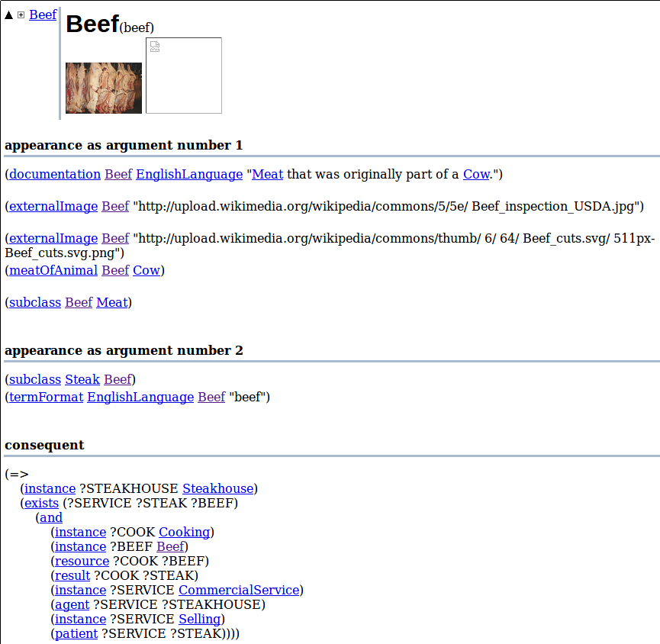
sigma.ontologyportal.org

Slide 32
Summary
Human knowledge is rich and complex.
This makes it hard to formalize precisely.
Inference quickly becomes intractable.
The formalist approach is “brittle”: any small change can cause inference to fail.
What is the alternative to formal representation?
Use machine learning to develop statistical models of the world.
Requires massive amounts of training data, but we have that now.
Works best for pattern recognition tasks.
Doesn’t work so well for tasks requiring complex inference.
Bottom line: machines cannot yet think like humans.

